Slide 1
WATER PIPELINE BLOCKAGE DETECTION SYSTEM
Guided By:
Dr. K. Lalitha,
Assistant Professor,
Dept of AI & DS.
PRESENTED By :
Gobika. I (22AI015)
Kanishgaa. A (22AI019)
Narmatha. M (22AI029)
TEAM NO: 13
22AIC14 : Internet of Things & It’s Application

Slide 2
Abstract
This project presents an IoT-based system for real-time detection and monitoring of blockages in pipelines.
By integrating IoT sensors, the system can automatically identify the location of potential blockages.
This significantly improves operational efficiency and reducing repair costs by addressing issues before they escalate.

Slide 3
Objectives:
To develop a system capable of continuously monitoring pipelines and detecting location of blockages in real-time using IoT sensors.
To reduce pipeline downtime by enabling active maintenance and automated blockage alerts
To reduce maintenance costs by preventing severe pipeline damage through timely detection of potential blockages

Slide 4
Components Required:
Arduino Nano
Flow Rate sensor
LED
Resistors
Connecting wires
USB Cable

Slide 5
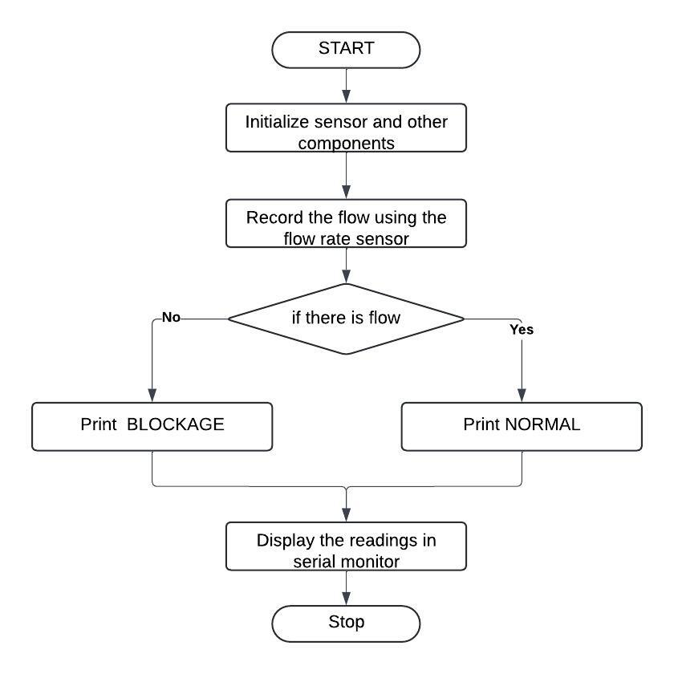
Flow Diagram:

Slide 6
Implementation:
Physical sensors are installed in the pipeline to monitor conditions like flow rate and potential blockages.
Additionally, It has the efficiency to detect the location of the blockage in the pipeline.
Hardware components transmit data from the sensors to the serial monitor.

Slide 7
Implementation:
Arduino IDE
Tinker Cad (designing)

Slide 8
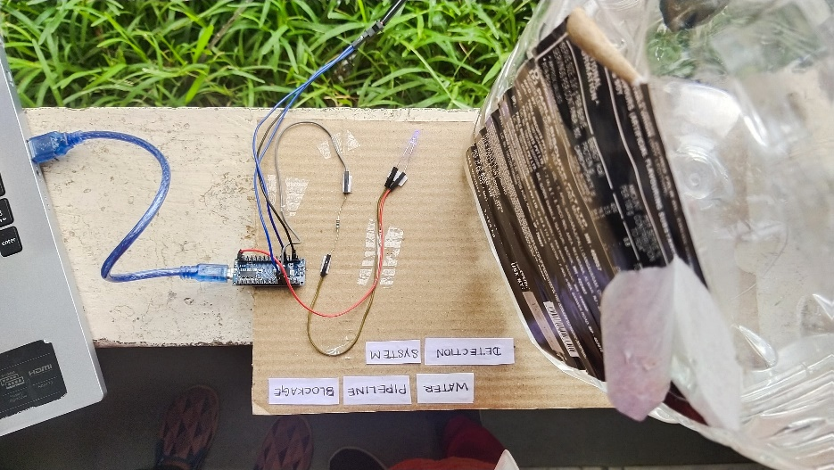
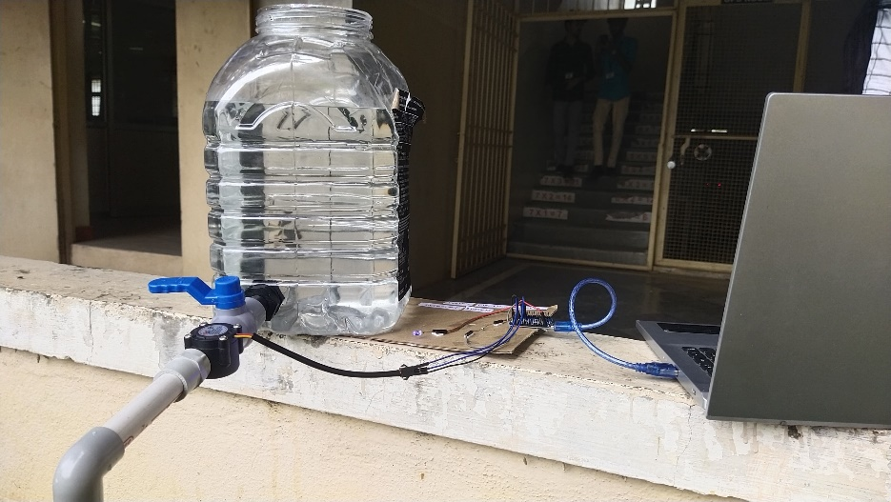
Output Screenshot:

Slide 9
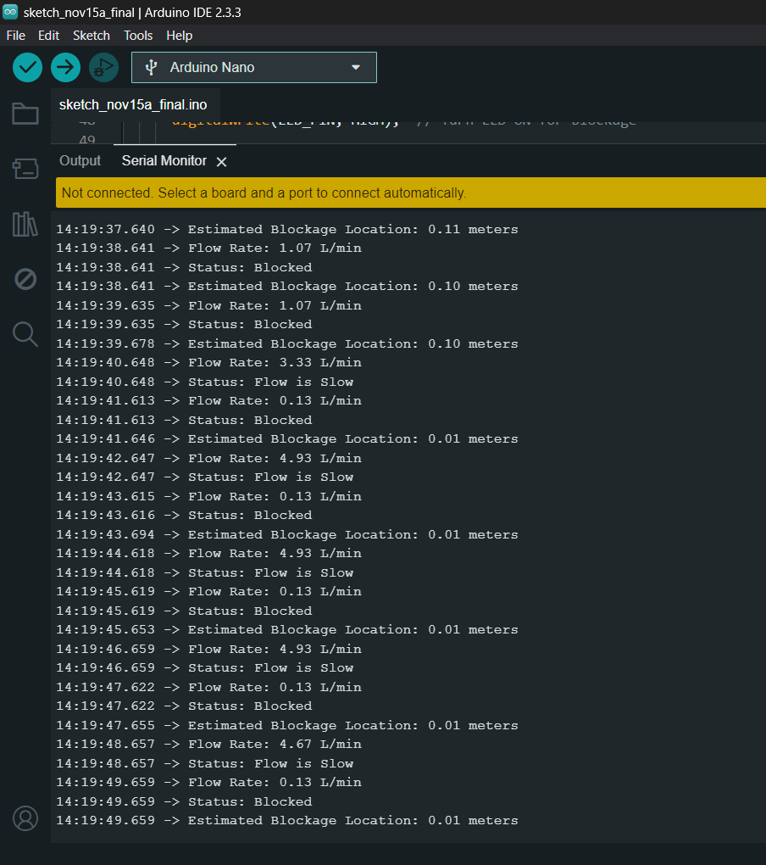
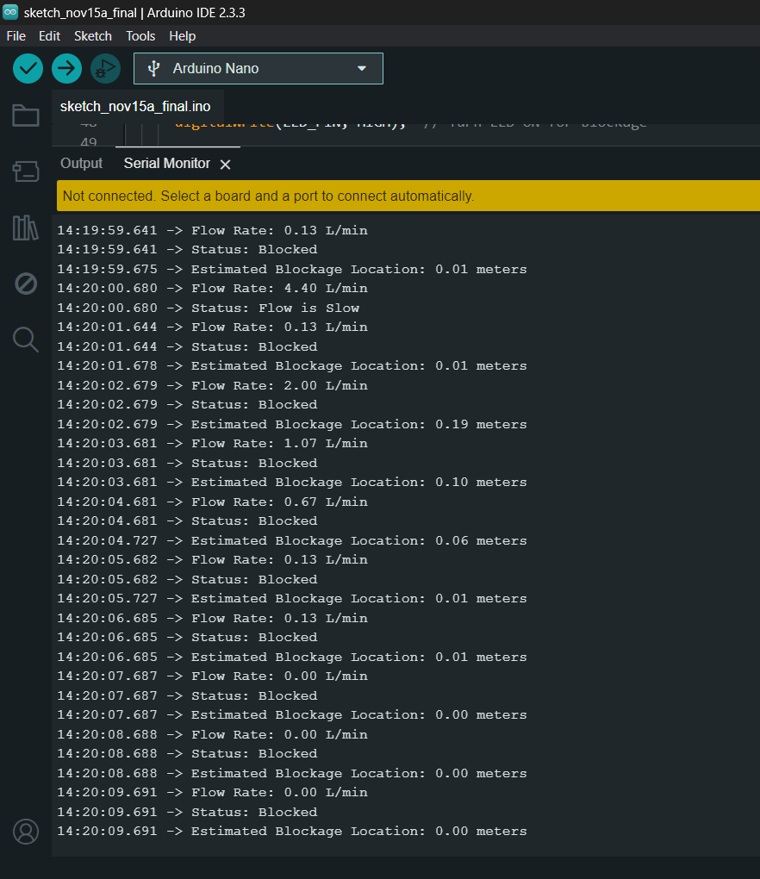
Output Screenshot:

Slide 10
THANK YOU
Guided By :
Dr. K. Lalitha,
Assistant Professor,
Dept of AI & DS.
PRESENTED By :
Gobika . I (22AI015)
Kanishgaa . A (22AI019)
Narmatha . M (22AI029)
TEAM NO: 13
22AIC14 : Internet of Things & It’s Application

